Slide 1





C2HLSC
Leveraging LLMs to refactor C code into HLS‑compatible C
Luca Collini, Andrew Hennessee, Ramesh Karri, Siddharth Garg
Notes:
TODO:
Add qr code to paper at beginning and end
Add qr to repo at end
Overview

Slide 2

What do system architects do?
Notes:
WHat do system architects do? system options -> constraints ->dse

Slide 3
What do system architects do?
1
Profile application
f_{C}(f_{A}) + f_{A}(f_{B})
Notes:
WHat do system architects do? system options -> constraints ->dse

Slide 4
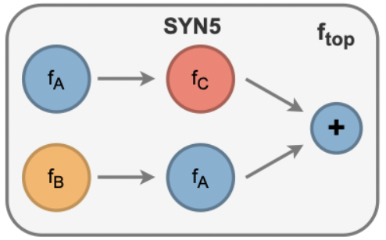
What do system architects do?
1
Profile application
2
Construct DFG
f_{C}(f_{A}) + f_{A}(f_{B})
Notes:
WHat do system architects do? system options -> constraints ->dse

Slide 5
What do system architects do?
1
Profile application
2
Construct DFG
f_{C}(f_{A}) + f_{A}(f_{B})
Model latency
3
Notes:
WHat do system architects do? system options -> constraints ->dse

Slide 6

What do system architects do?
1
Profile application
2
Construct DFG
f_{C}(f_{A}) + f_{A}(f_{B})
Model latency
3
4
DSE to map kernels to hardware
Notes:
WHat do system architects do? system options -> constraints ->dse

Slide 7



Can LLMs replace system architects?
1
Profile application
2
Construct DFG
f_{C}(f_{A}) + f_{A}(f_{B})
Model latency
3
4
DSE to map kernels to hardware
Notes:
WHat do system architects do? system options -> constraints ->dse

Slide 8
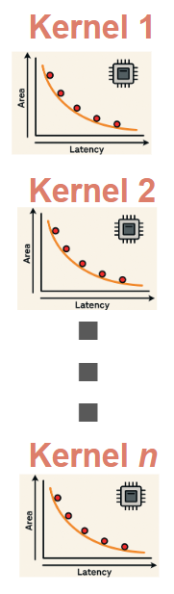
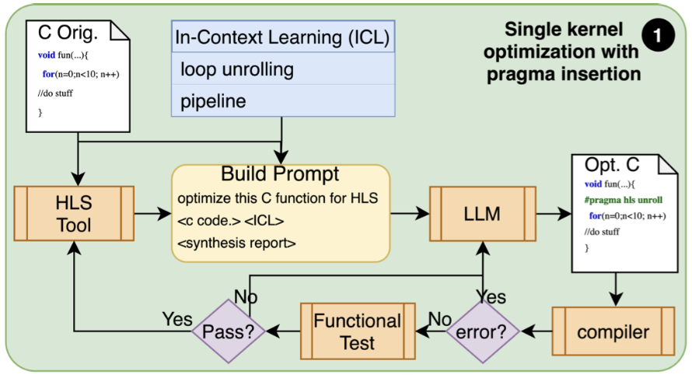
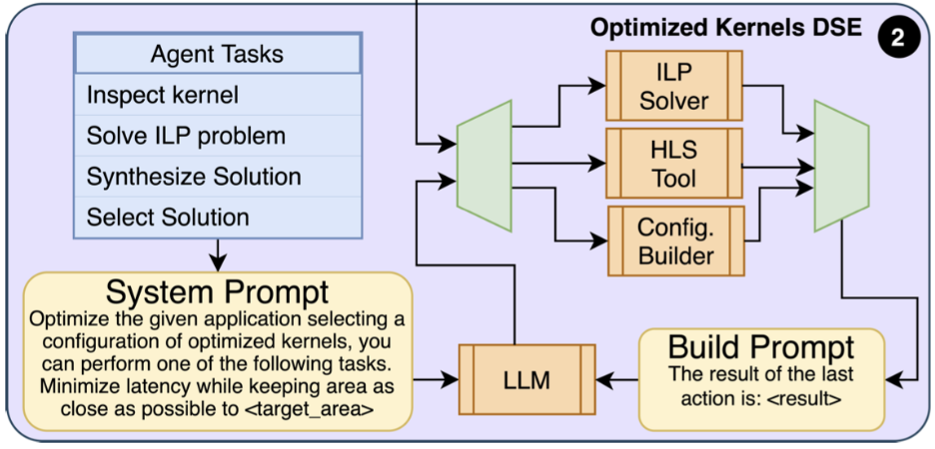
Overview of proposed flow
Single Kernel Optimization
Full System Composition

Slide 9

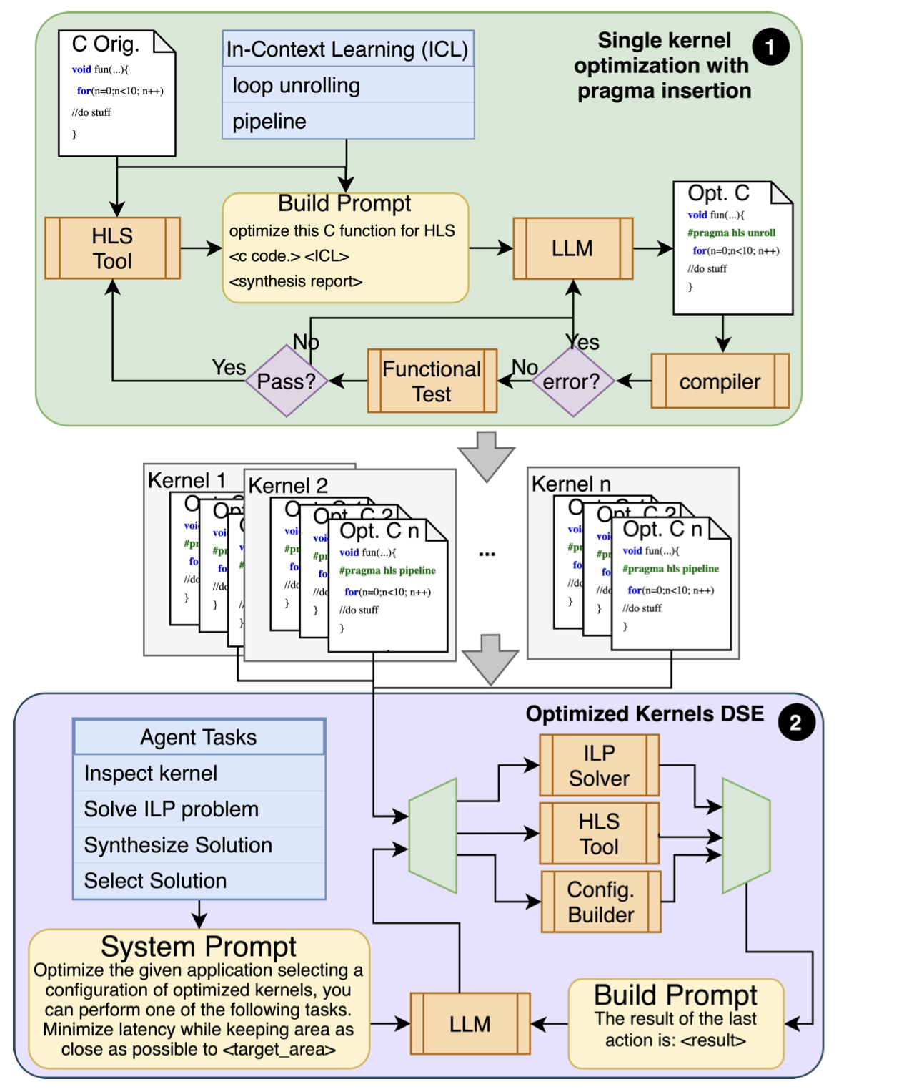
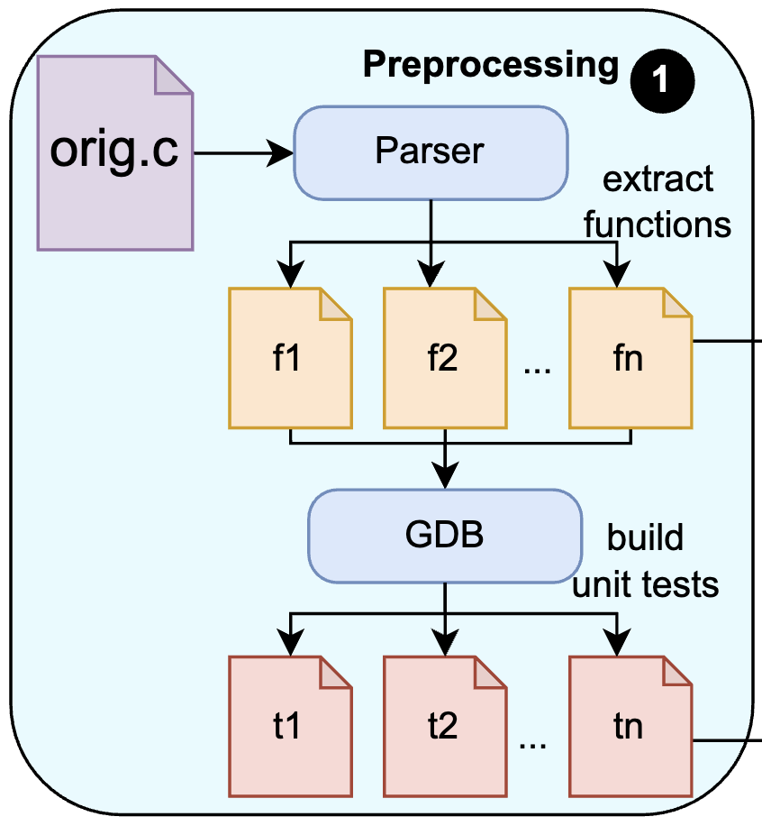

Single kernel optimization via pragma insertion
(C2HLSC, TODAES)
Notes:
Add journal QR And dive in tests

Slide 10
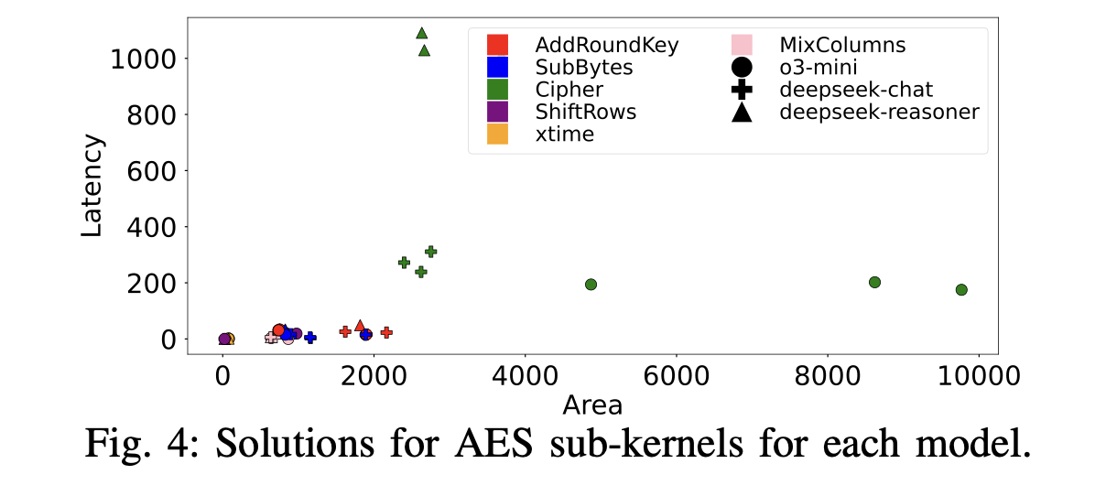
Design points for DSE

Slide 11
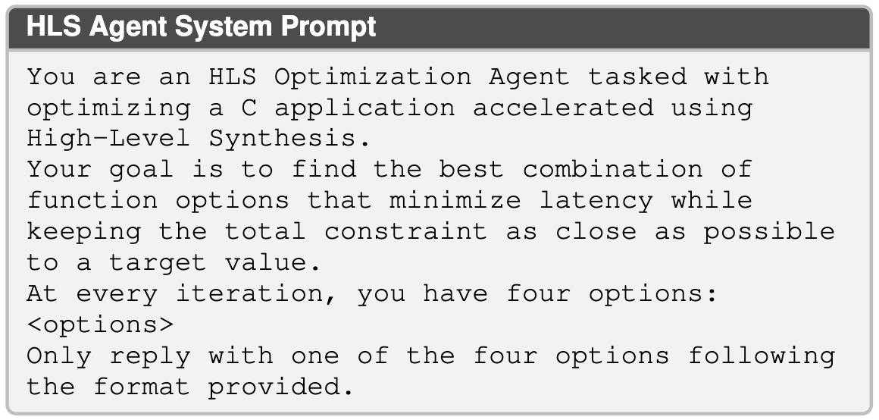
DSE of optimized kernels
Notes:
Get rid of prompt

Slide 12
Thank you!

